Slide 1

CHAPTER SEVEN
File I/O
By: Behayilu M.
Faculty of Computing and Software Engineering,
Arba Minch Institute of Technology(AMiT),
Arba Minch University

Slide 2
Introduction
Data stored in the program are temporary; they are lost when the program terminates.
To permanently store the data created in a program it is saved in a file on a disk or other permanent storage device.
Java uses the concept of a stream to make I/O operation fast. I/O means Input/Output.
A stream can be defined as a sequence of data.
An I/O Stream is a sequence of data that is read from a source and write to a destination.
All these streams represent an input source and an output destination.
The java.io package contains all the classes required for input and output operations.
Source
Input
Program
Output
Destination
Stream
Stream
Keyboard or file
Screen or file
2

Slide 3
The Java File Class
Java File class represents the files and directory pathnames in an abstract manner.
The File class is useful for retrieving information about files or directories from disk.
The File class contains the methods for obtaining the properties of a file/directory and for renaming and deleting a file/directory.
The File class has different methods which can be used to manipulate the files.
  Absolute path: An absolute file name (or full name) contains a file name with its complete path and drive letter.
  Relative path: A relative file name is in relation to the current working directory.

Slide 4
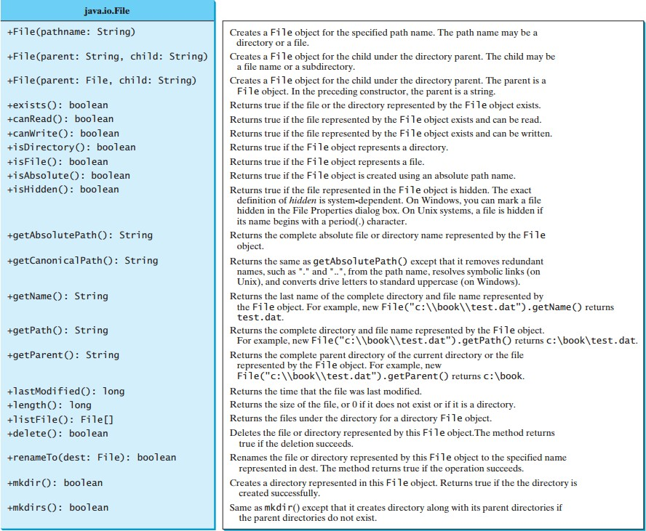
The File Class

Slide 5
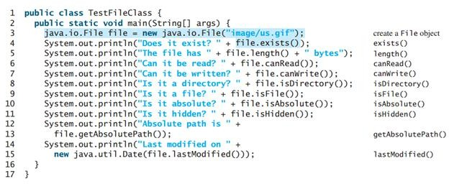
Example: The File Class
This program demonstrates how to create a File object and use the methods in the File class to obtain its properties.
The program creates a File object for the file us.gif.
The lastModified() method returns the date and time when the file was last modified.

Slide 6
Text File and Binary File
There are two types of files: Text file or Binary file.
Data stored in a Text file are represented in human-readable form.
Data stored in a binary file are represented in binary form. You cannot read binary files.
Binary files are designed to be read by programs.
For example, the Java source programs are stored in text files and can be read by a text editor, but the Java .class files are stored in binary files and are read by the JVM.
The advantage of binary files I/O are more efficient to process than text files I/O, because binary file I/O does not require encoding and decoding. But Text file I/O requires encoding and decoding.
For example, the decimal integer 199 is stored as the sequence of three characters: '1', '9', '9' in a text file and the same integer is stored as a byte-type value C7 in a binary file, because decimal 199 equals to hex C7.

Slide 7
Text File Input and Output
The Scanner class uses for reading text data from a file and the PrintWriter class uses for writing text data to a file.
Text data is read using the Scanner class and written using the
PrintWriter class.
To create an object using Scanner class is:
Scanner input = new Scanner(new File(filename));
To create an object using PrintWriter class is:
PrintWriter output = new PrintWriter(filename);

Slide 8
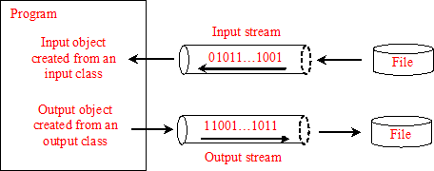
Text File Input and Output
Scanner input = new Scanner(new File("temp.txt")); System.out.println(input.nextLine()); input.close();
PrintWriter output = new PrintWriter("temp.txt");
output.print("Java 101"); output.close();

Slide 9
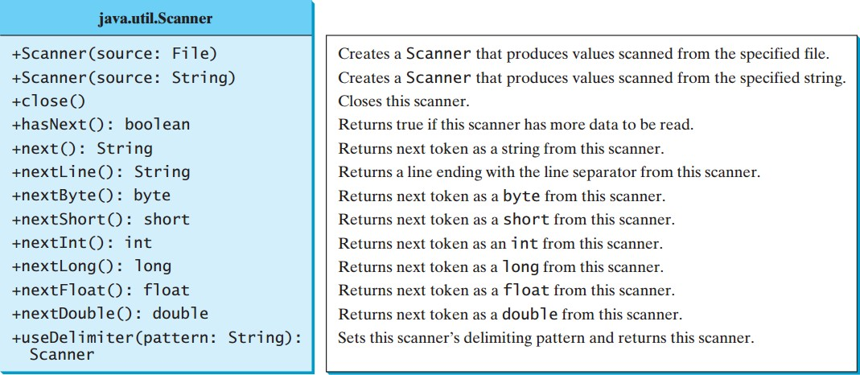
Scanner Class

Slide 10
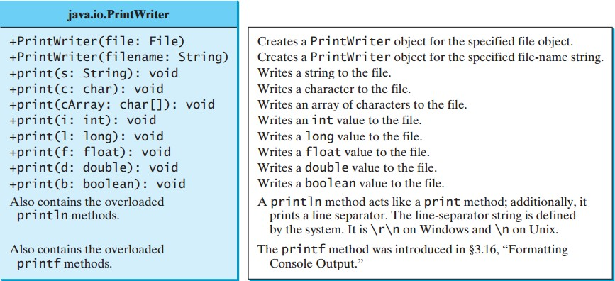
PrintWrite Class

Slide 11
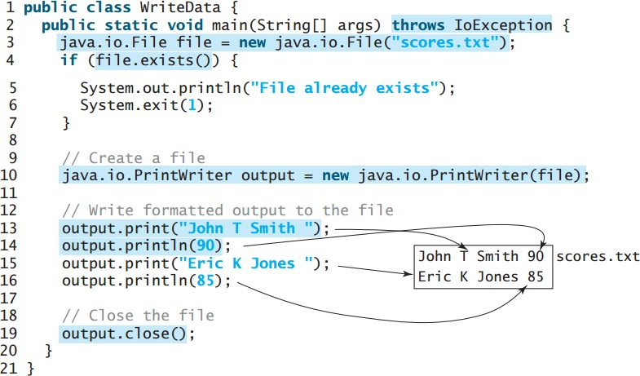
Example: writing data using PrintWriter

Slide 12
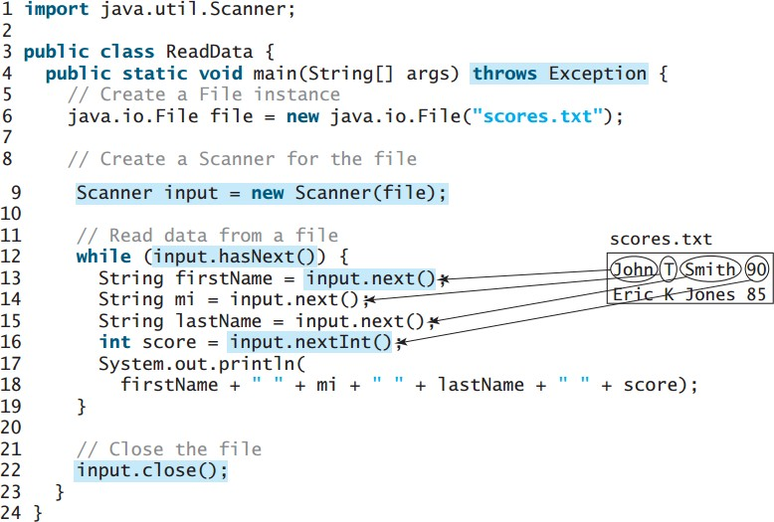
Example: reading data using Scanner

Slide 13
Standard I/O Streams
All the programming languages provide support for standard I/O where the user's program can take input from a keyboard and then produce an output on the computer screen.
Java provides the following three standard streams:
  Standard Input - This is used to feed the data to user's program and usually a keyboard is used as standard input stream and represented as System.in.
  Standard Output - This is used to output the data produced by the user’s program and usually a computer screen is used for standard output stream and represented as System.out.
  Standard Error - This is used to output the error data produced by the user’s program and usually a computer screen is used for standard error stream and represented as System.err.

Slide 14
--END--

